Slide 1


CMS
Content is The King!

Slide 2
Meet our team
members
Supervision
Head of department
Shymaa Kilany
Israa Ahmed
Omnia Abdelhamed
Ahmed Fathelbab

Slide 3
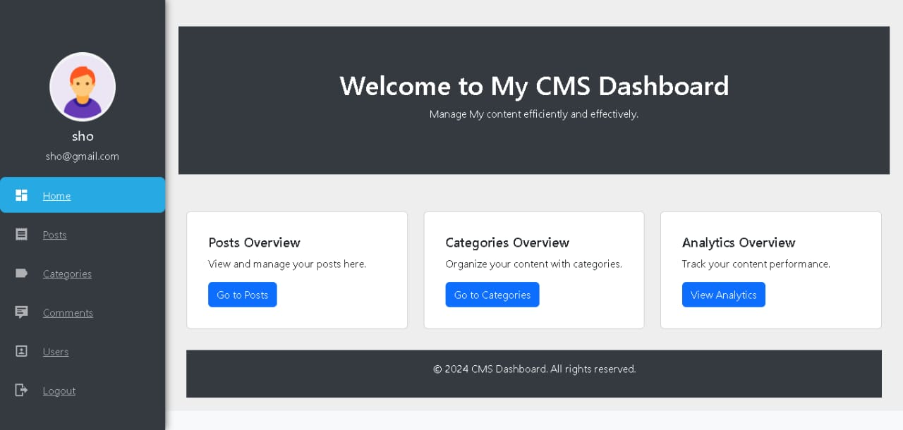
Agenda
Why CMS?
What is CMS?
CMS and business
Technologies
Future work
demo

Slide 4
Why CMS
A CMS simplifies content creation, editing, and management without needing extensive technical knowledge, allowing users to easily maintain dynamic websites.
Why CMS

Slide 5
PRIMARY
GOAL
Enable users to efficiently manage and update website content with minimal technical effort.

Slide 6
What is CMS?
This project is a custom-built Content Management System (CMS) using Laravel, designed to provide an intuitive interface for managing website content, including creating, editing, and organizing pages, posts, and media

Slide 7
CMS And Business
Limited flexibility without customization
Easy content management
strengths
weaknesses
Scalability for various industries
Security vulnerabilities if not regularly updated
opportunities
threats

Slide 8
Technologies
Back-end
Front-end
database
PHP -> Laravel framework
Html
CSS
Bootstrap
MySQL

Slide 9
Flow
Explore Posts
View Post
Post Comment
user
login
View Dashboard
Review new users & Post
Post Publish
Review Comments
Add Category
Add User
admin
login

Slide 10
Future Work
1.Improve the search functionality: CMS could enhance the
search functionality on the website
to make it easier for users to find the posts
that meet their specific needs. This could include adding
filters for keywords, authors, and categories.
2. Add labels: CMS could add labels to group the related posts together to enhance the reader experience and increase the retention time.

Slide 11
Demo time
←------------------------------------------------------------------------------------------------------------→
Demo time

Slide 12
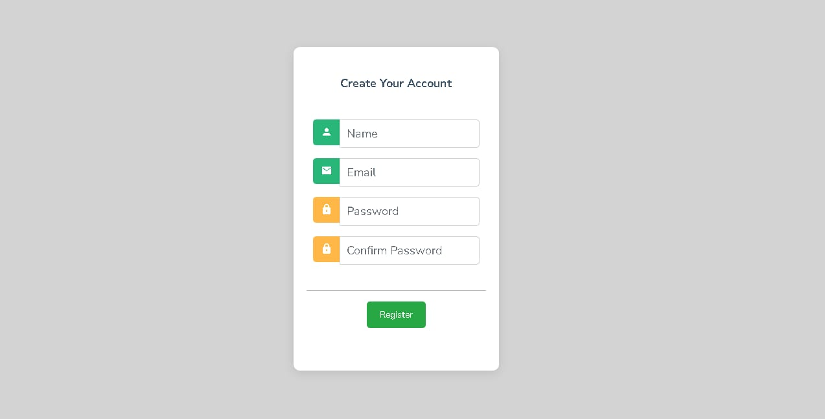

Slide 13
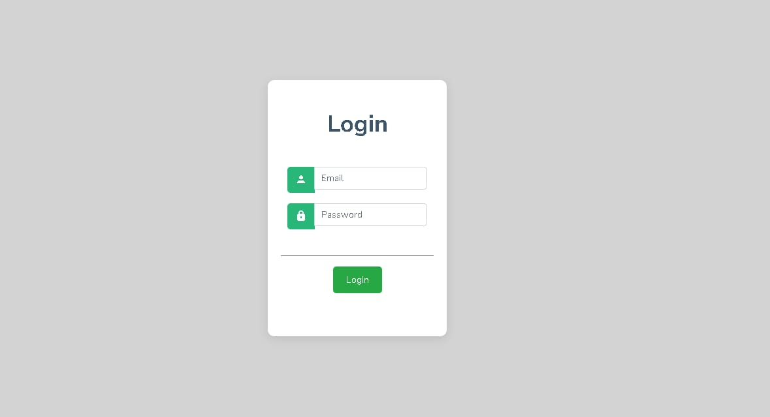

Slide 14
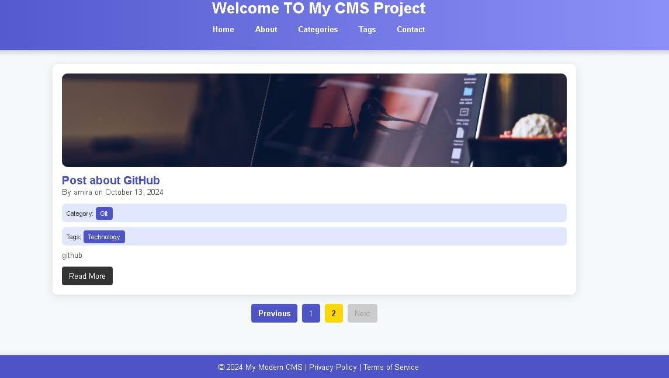

Slide 15
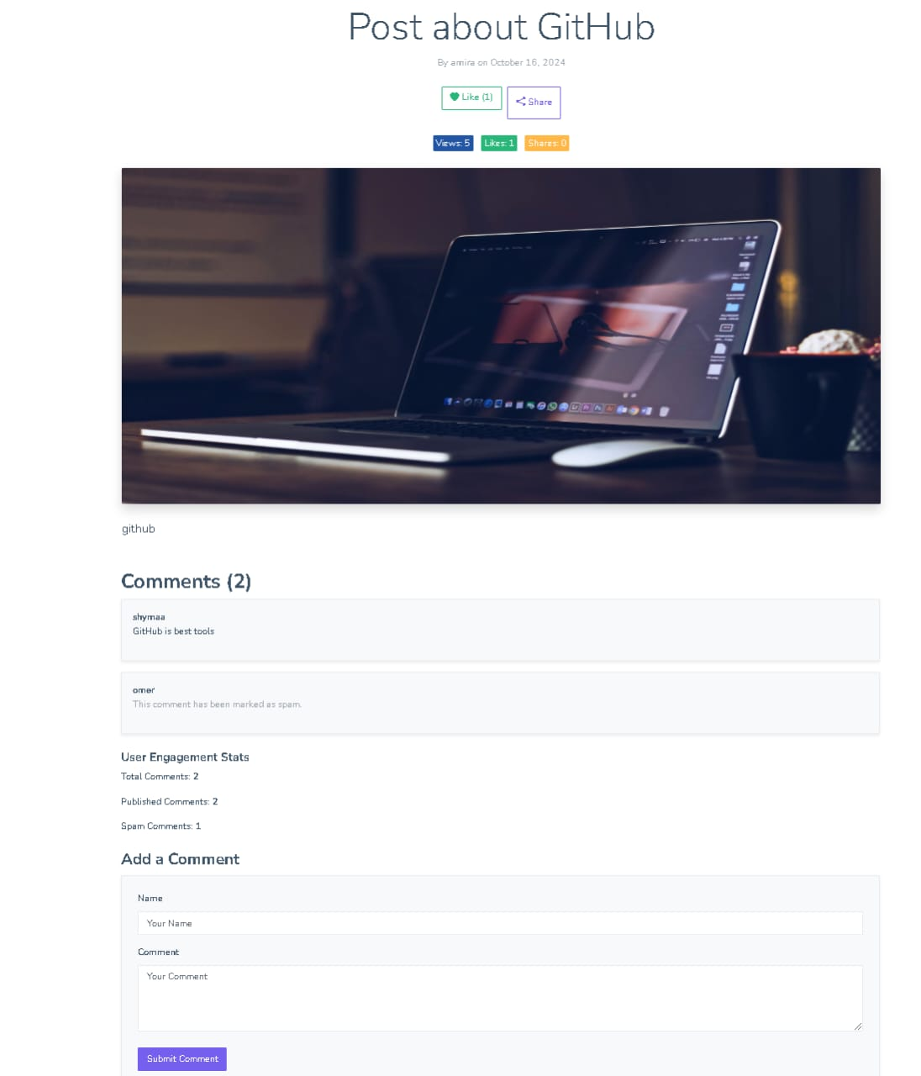

Slide 17
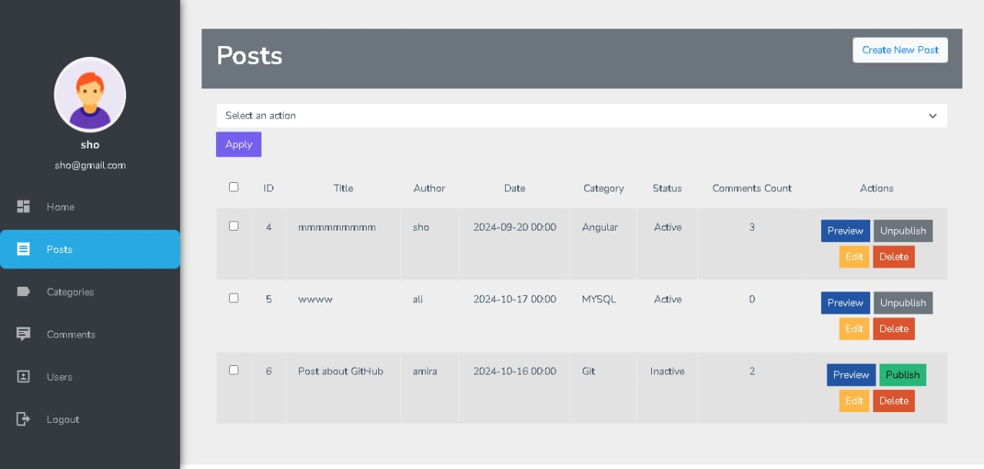

Slide 18
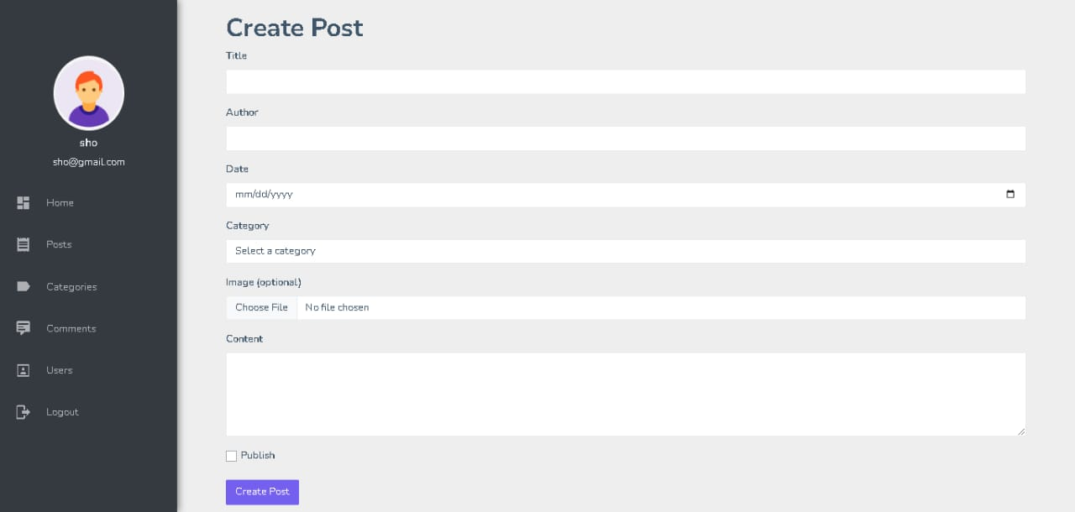

Slide 19
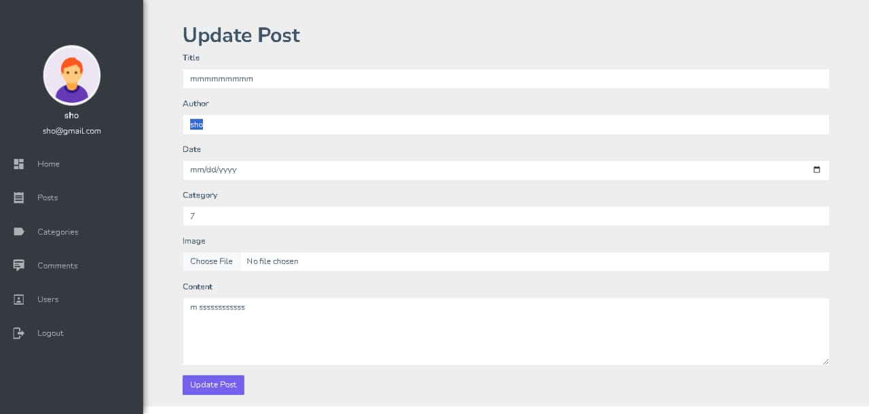

Slide 20
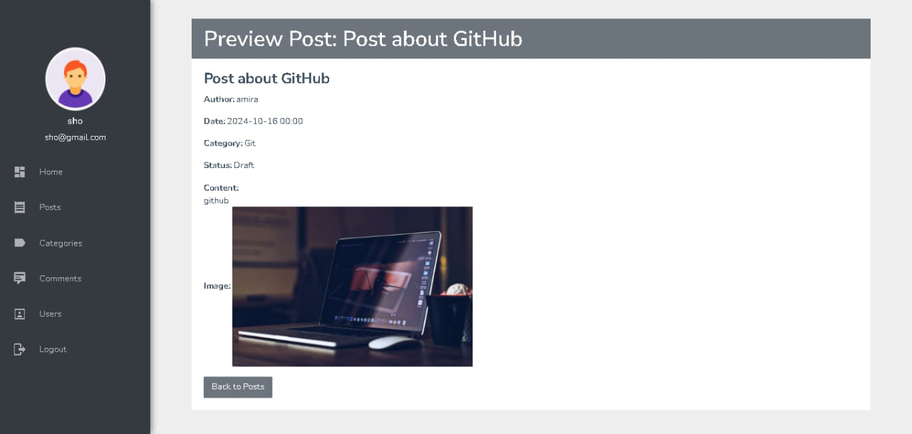

Slide 21
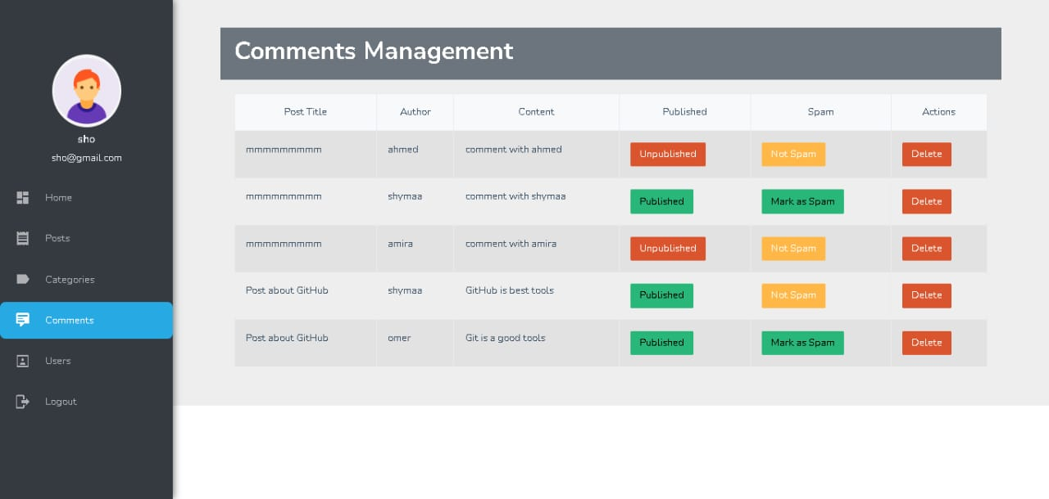

Slide 22
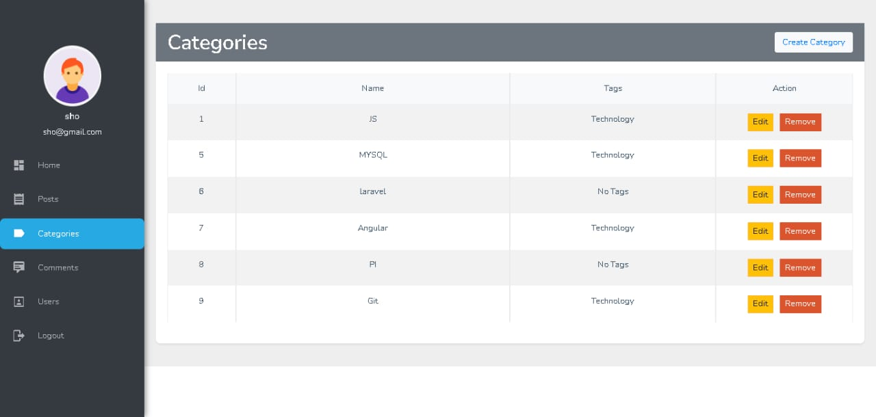

Slide 23
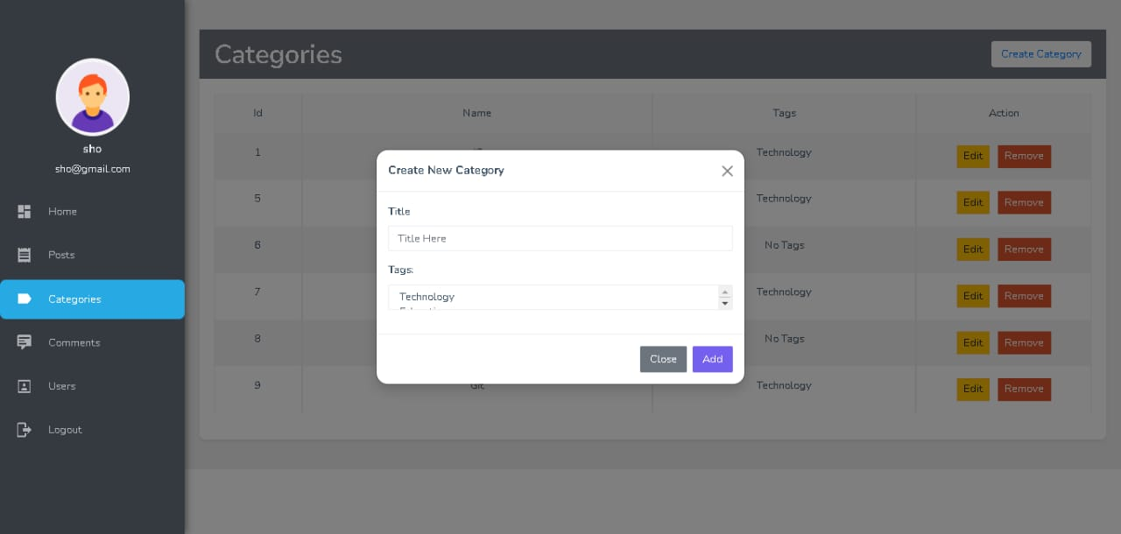

Slide 24
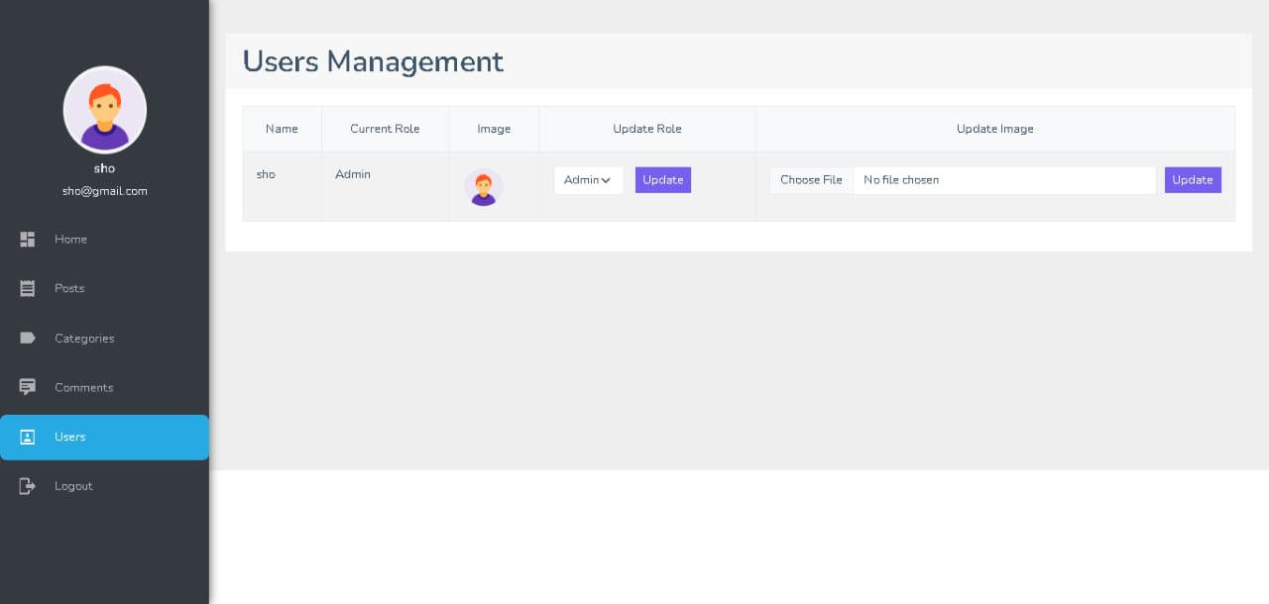

Slide 25


THANK
YOU
Any Questions?

